Slide 1
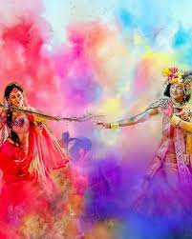
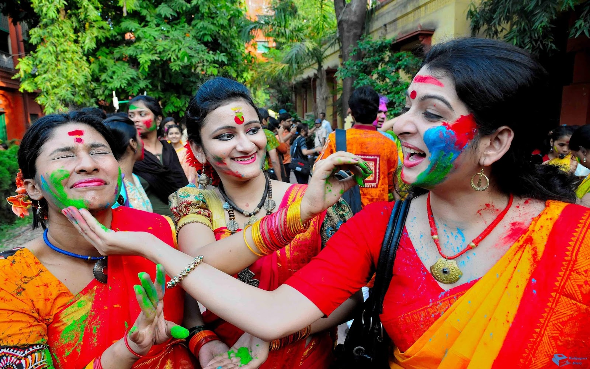
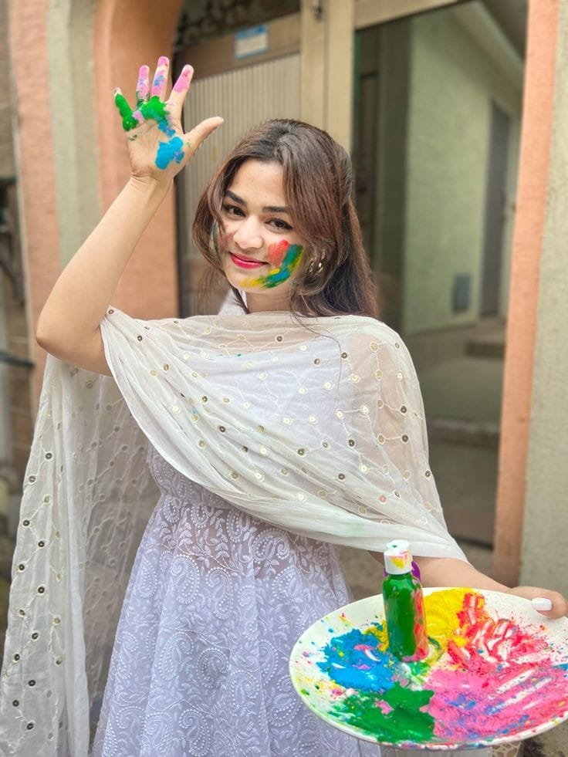
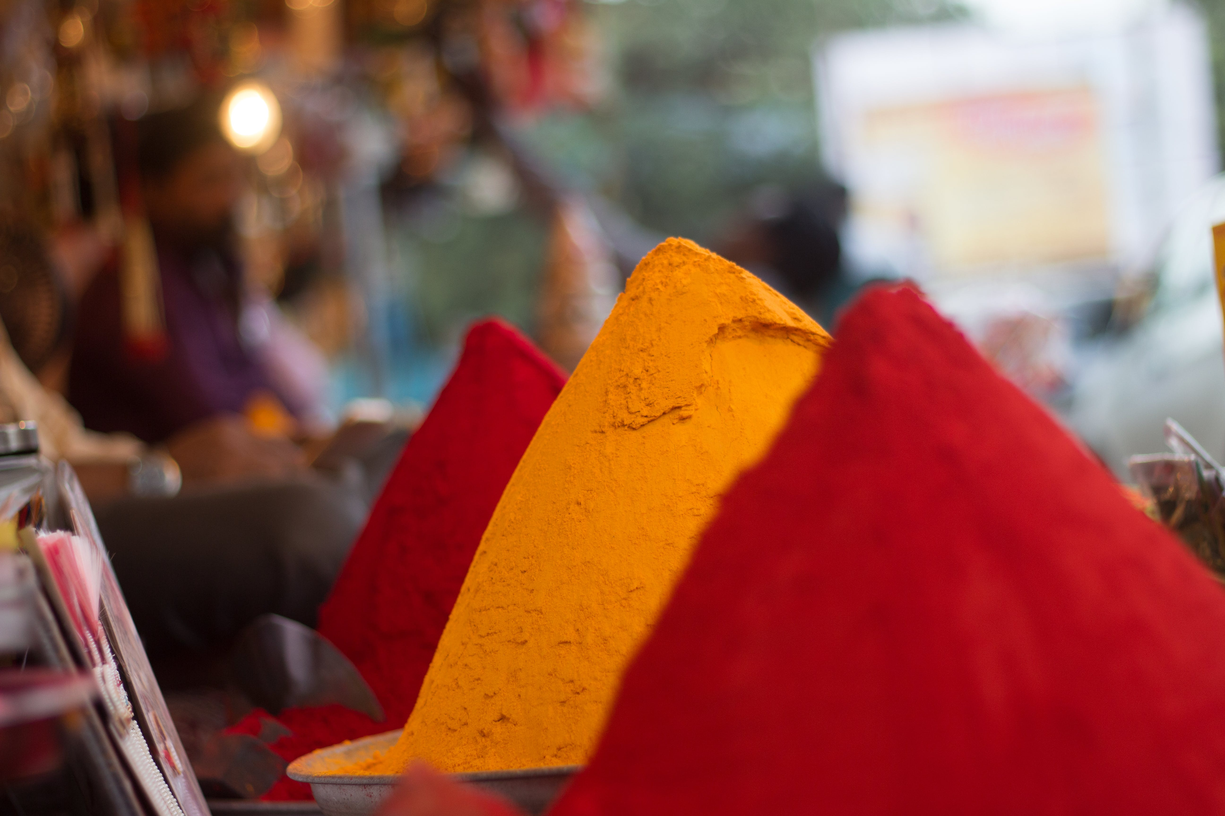
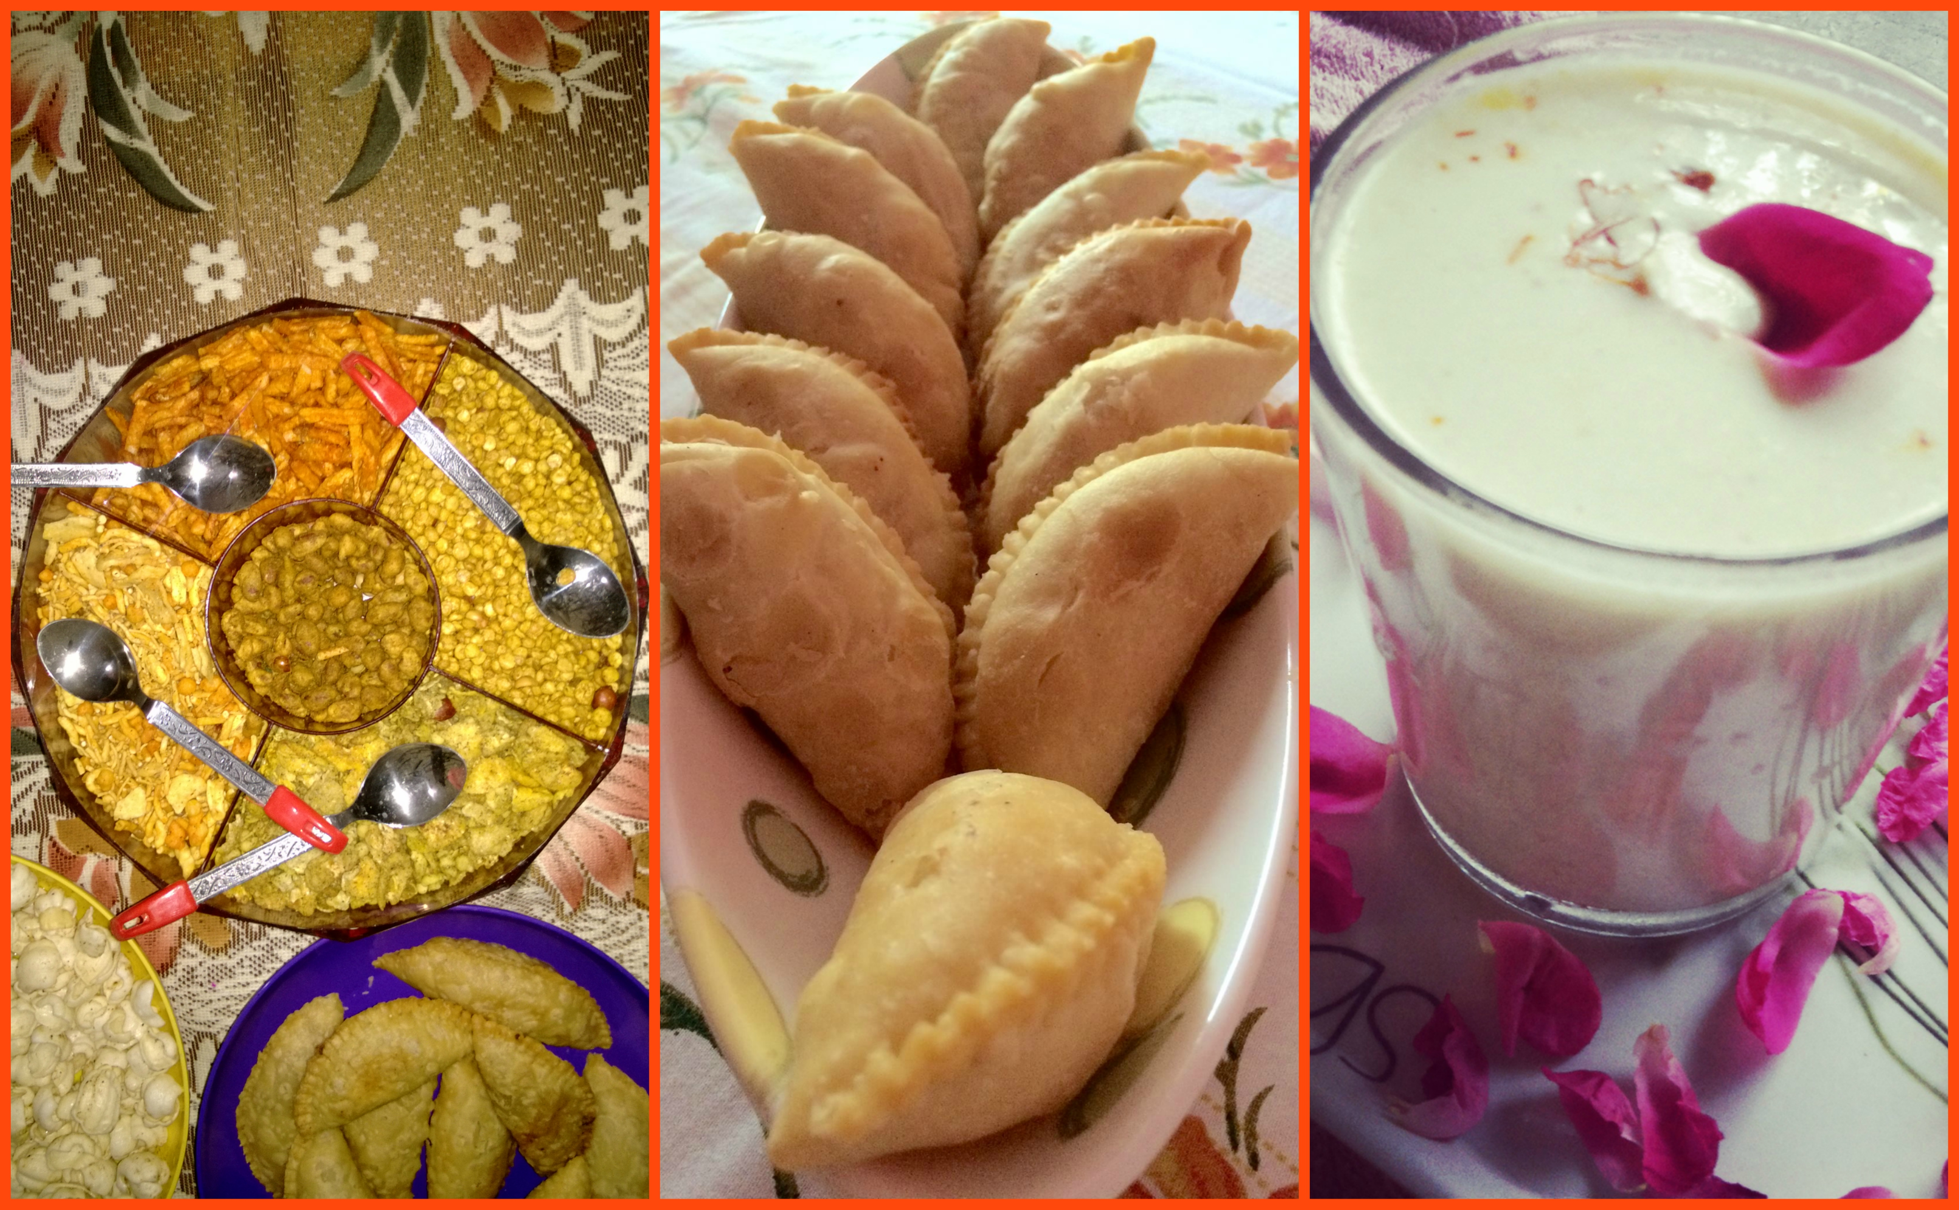
holi festival

Slide 2
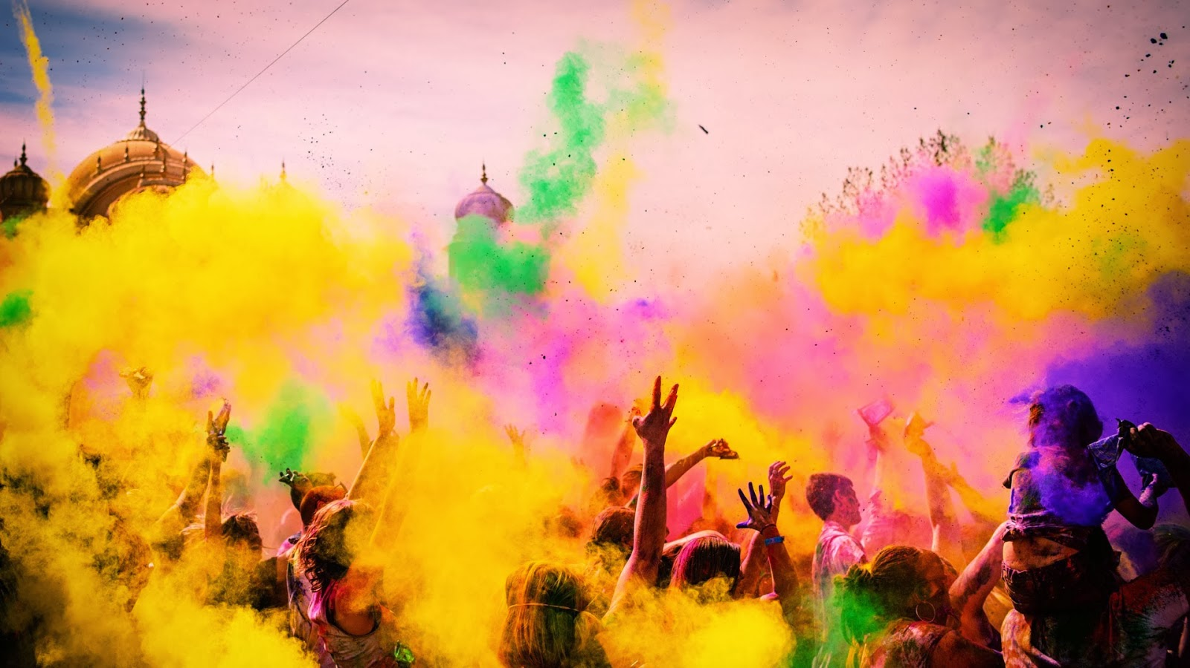
objectives
*To describe what is the Holi festival?
*To tell origin,history of Holi festival
*To talk about cultural and religious concept
*To aware of foods,clothing,decorations in Holi
*To tell entertainment purpose
*To describe modern adaptations
*To talk about global spread

Slide 3
outline
Introduction
1.Origin , history of Holi festival
1.1 Roots in ancient Hindu mythology
1.2 Celebrating the love between Lord Krishna and Radha
1.3 In ancient times Holi is celebrated mainly in North India
1.4 Holi has become a global recognition and is celebrated in many
countries
2.Cultural and religious concept
2.1 The festival starts with a prayer of Lord Shiva
2.2 The festival is celebrated in two days
2.3 Holi is also a festival of harmony

Slide 4
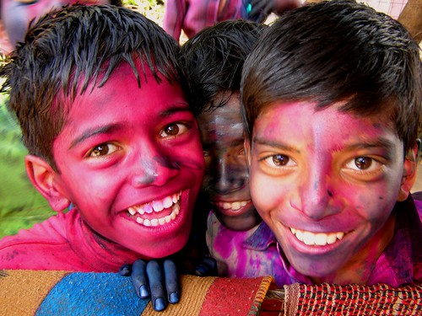
3.Foods , clothing and decorations
3.1 Favourite Indian snacks, desserts,dishes and beverages
3.2 Dress up in their best traditional clothes
3.3 Use traditional colours such as red ,yellow, green and blue to create
a bright and festive atmosphere
4.Entertainment activities
4.1 Playing with colors
4.2 Music and dance
4.3 Water Balloon Fights
4.4 Holi parties

Slide 5
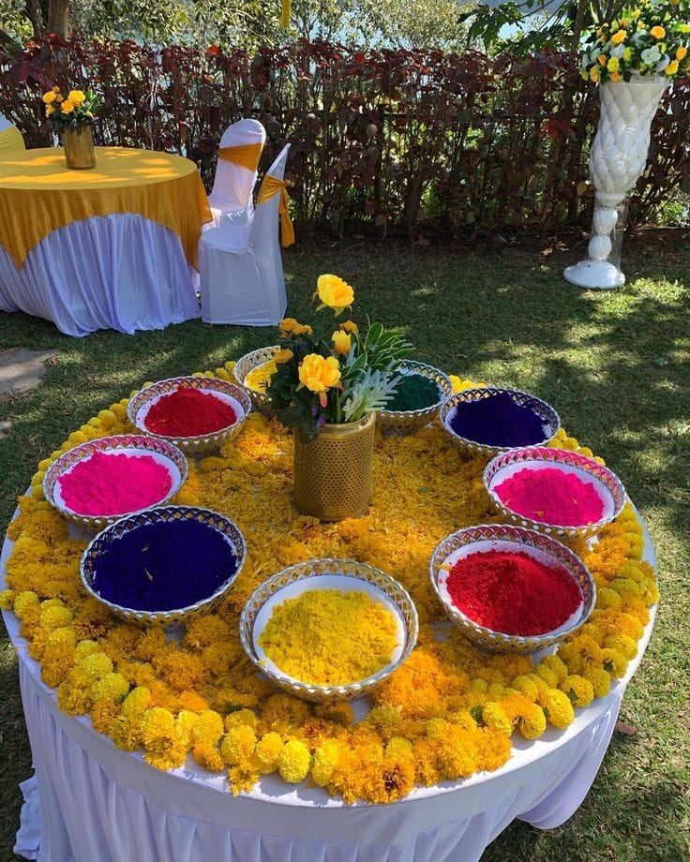
5.Modern adapters
5.1 Adaptation
5.2 Eco friendly celebrations
5.3 Commercialization
6.Global spread
6.1 How is Holi festival spread globally?
6.2 Holi now celebrating in many countries around the world
6.3 “The World’s biggest Holi” celebration is hosted in United States
Conclusion

Slide 6
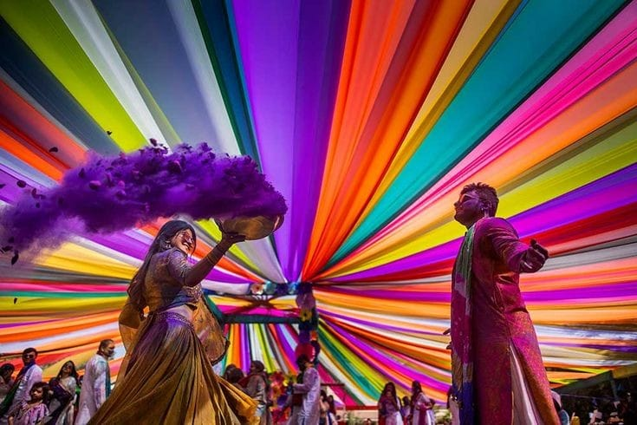
introduction
What is the Holi Festival ?
It called as the “ Festival of Love”
The word Holi draws smile and enthusiasm amongst the people.
Holi also celebrate the arrival of spring ,a season of joy and hope.

Slide 7
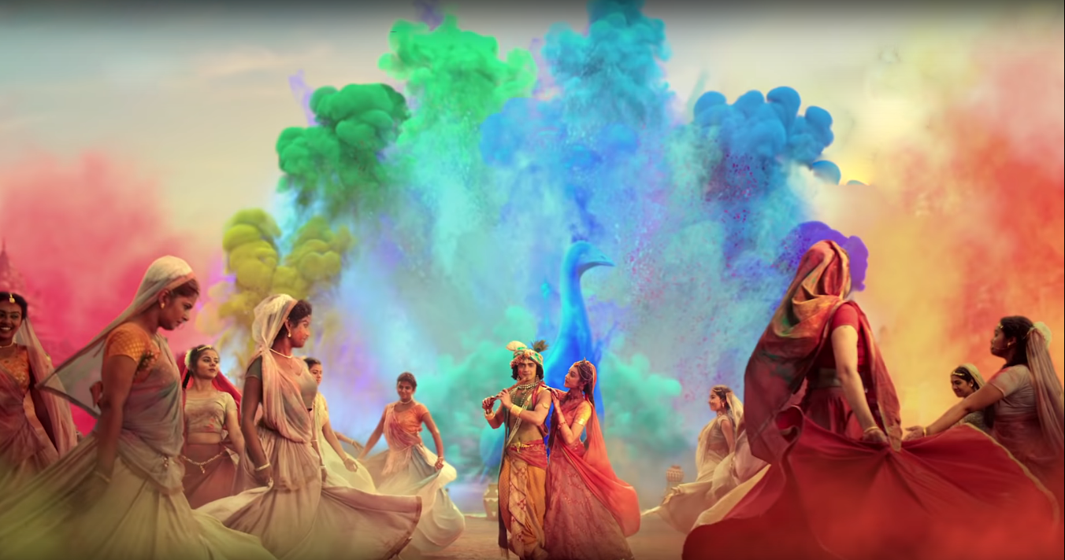
1.Origin ,history of holi festival
1.1 Roots in ancient Hindu mythology
Holi festival has its roots in ancient Hindu mythology, celebrating the love between Lord Krishna and Radha and it is also known as festival of colours.
1.2 Celebrating the love between Lord Krishna and Radha
young Krishna trying to change Radha's skin color is symbolized by throwing colored powders and water during Holi.

Slide 8
1.3 In ancient times Holi is celebrated mainly in North India
In ancient times Holi is celebrated mainly in North India, has now become a nationwide and global festival.
1.4 Holi has become a global recognition and is celebrated in many countries
Currently Holi has become a global recognition and is celebrated in many countries as a symbol of unity, diversity, and the shared human experience.

Slide 9
2.Cultural and religious concept
2.1 The festival starts with a prayer of Lord Shiva
- There are many cultural and religious concepts to mark the Holi festival.
- The festival starts with a prayer of Lord Shiva.
- They believed Lord Shiva as the destroyer of all evil & darkness.
2.2 The festival is celebrated in two days
- On the first day people gather around the burning piles of wood and cow dung , called 'Bonfires’.
- On the second day people of all ages play with colored water & colored "gulal' prepared by powdered colors.

Slide 10
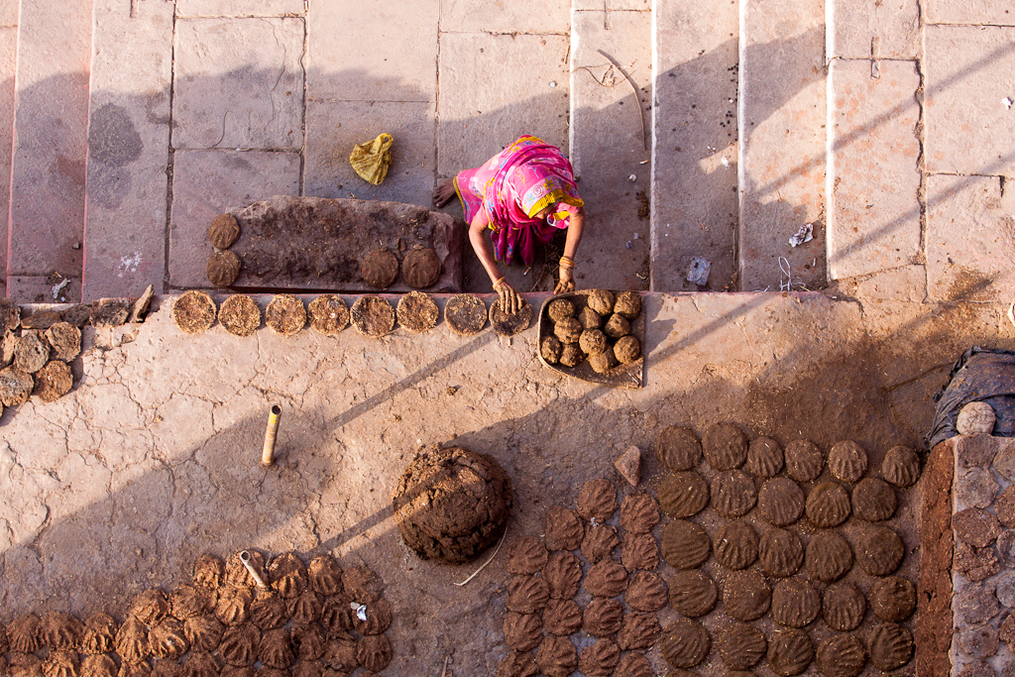
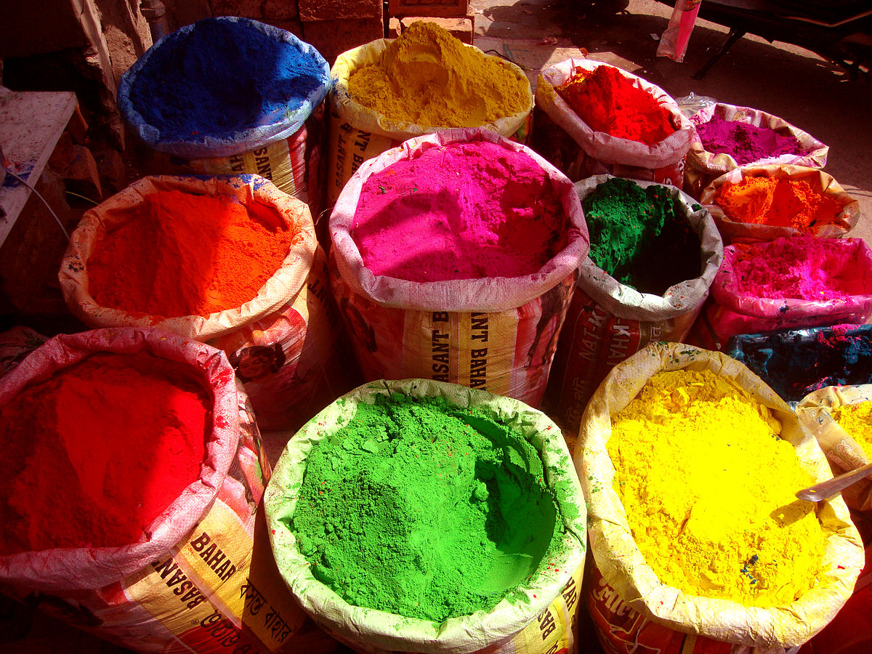
2.3 Holi is also a festival of harmony
In the evening of the Holi day people visits their friends, relatives and neighbors. They treat them with sweats.

Slide 11
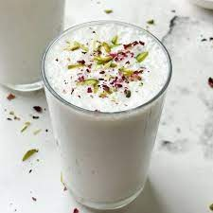
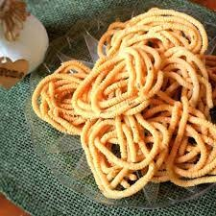
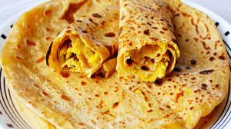
3.Foods, clothing & decorations
3.1 Favourite Indian snacks, desserts, dishes and beverages
Like any festival food plays an important part in Holi celebration.Here are their favourite Indian snacks, desserts,dishes and beverages.
- Gujiya
- Thandai
- Lassi
- Rasmali
- Coconut milk murukku
- Puran poli
- Ladoo

Slide 12
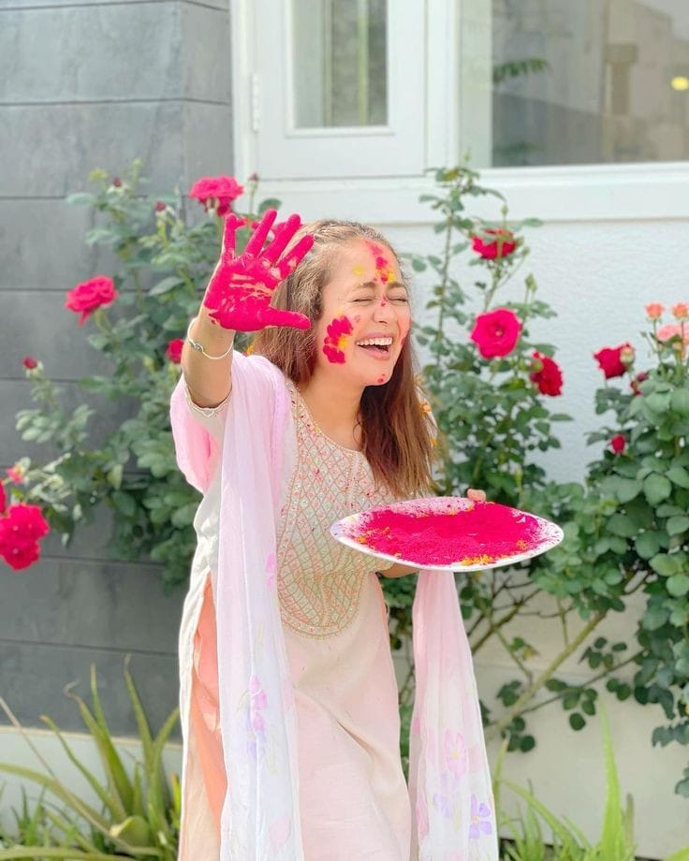
3.2 Dress up in their best traditional clothes
Indian people dress up in their best traditional
clothes.
which are usually bright and colourful, to reflect
the joyful and festive spirit of the occasion.
If it's holi Indian women tend to wear white
contemporary.

Slide 13
3.3 Use traditional colours such as red ,yellow, green and blue to create
a bright and festive atmosphere
Hindus celebrate Holi with traditional decorations such as diyas, colourful flowers garlands and rangolis.
Here are some Holi decoration ideas:
- Jazz up the walls with wall arts
- Beautiful lighting
- Spruce up with vibrant cushions covers and curtains
- Colourful dining table

Slide 14
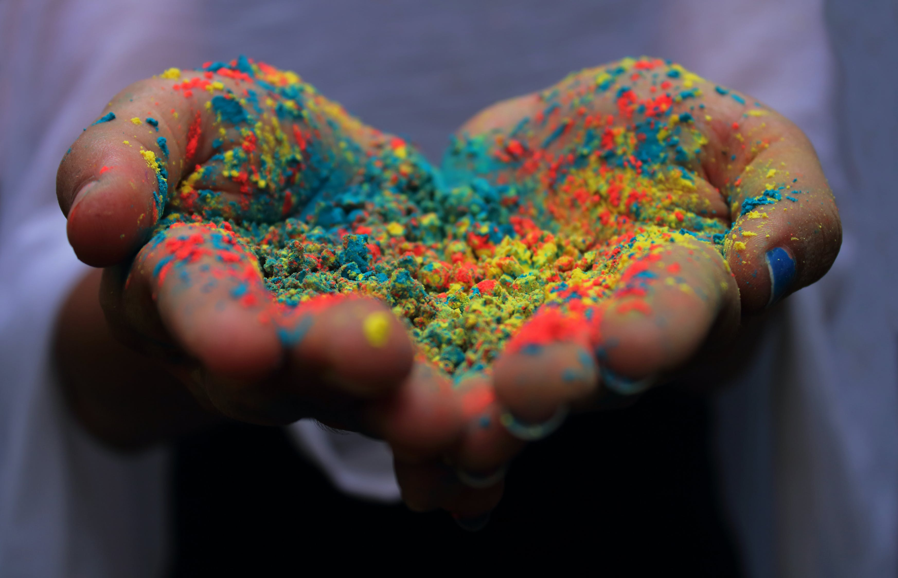
4.Entertainment activities
4.1 Playing with colors
The most iconic aspect of Holi is the throwing of colored powders and water on each other.
People use powdered colors (gulal) and water balloons to drench each other in a colorful mess.
This act of smearing colors is not only entertaining but also a symbol of unity and fun.

Slide 15
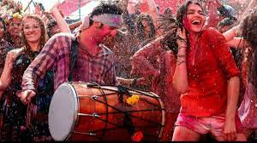
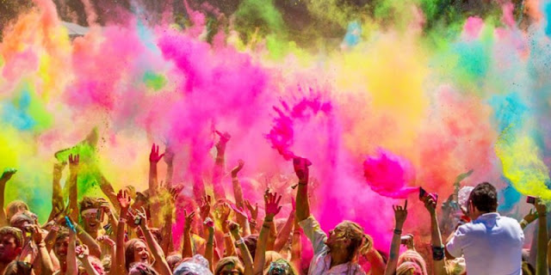
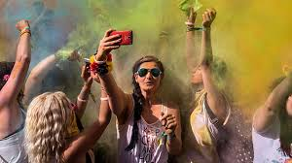
4.2 Music and dance
Music is an integral part of Holi celebrations.
People gather to sing and dance to traditional and modern Holi songs.
Popular Holi songs are often played, and people dance to the beats of drums and other instruments.

Slide 16
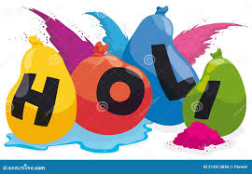
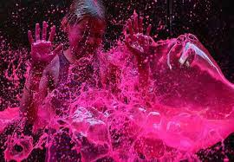
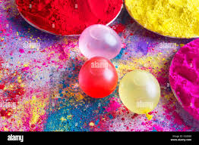
4.3 Water Balloon Fights
Water balloons filled with colored water are
used for playful water fights.
People aim at each other and enjoy
soaking themselves in water.
Which provides relief from the heat
of the spring season.

Slide 17
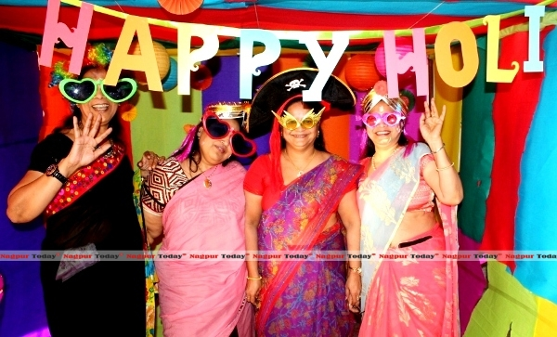
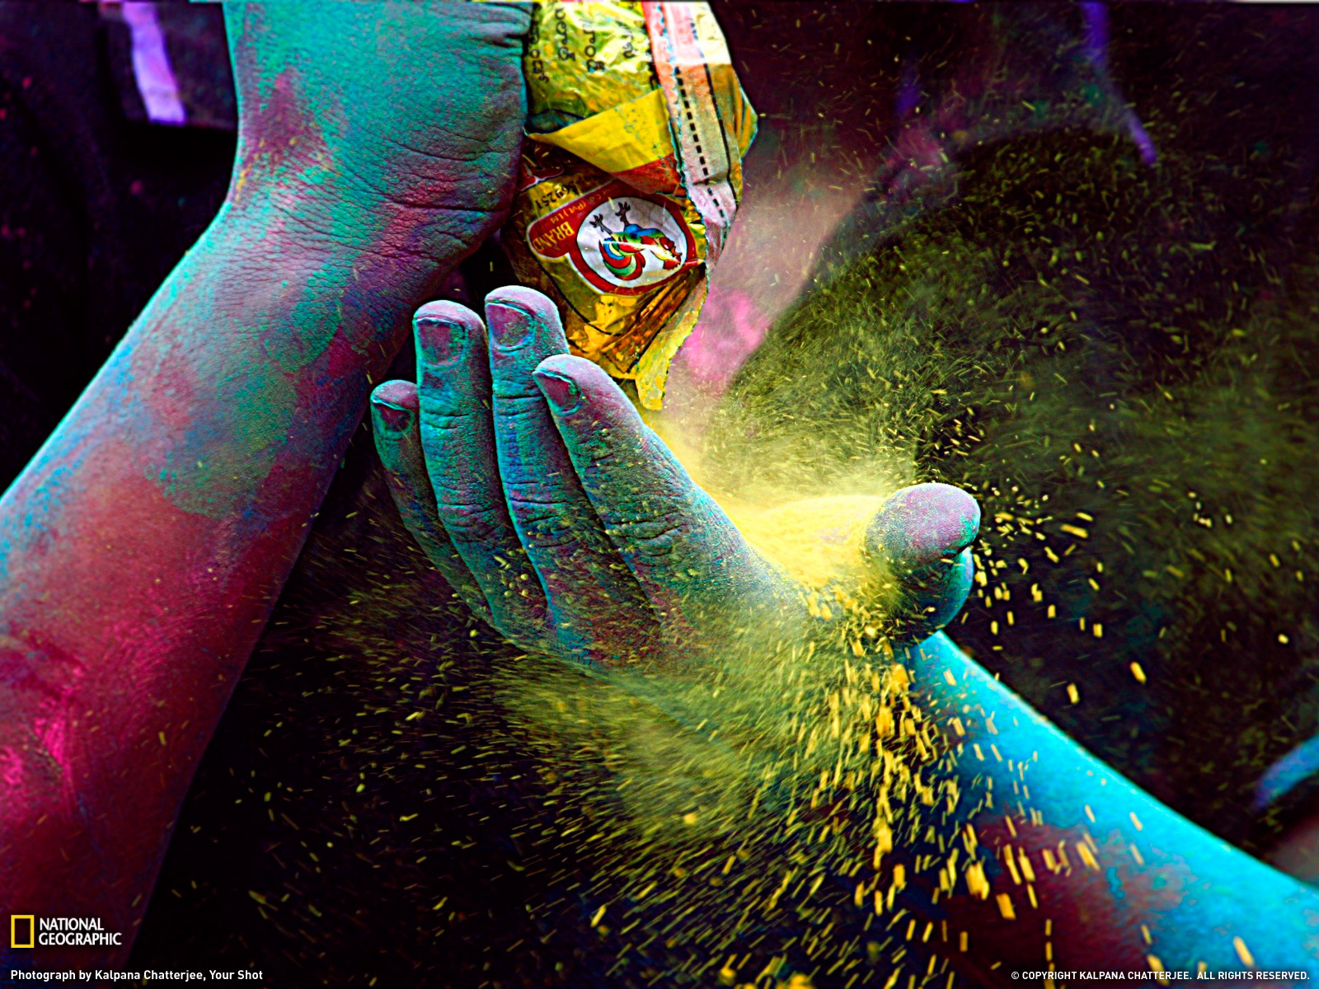
4.4 Holi Parties
Many people also celebrate holi
with parties and gatherings,
where they enjoy music
dance and food.

Slide 18
5.MODERN ADAPTATIONS
5.1 Technology and social media
- Virtual celebration
- Event promotion
- Educational content
5.2 Eco friendly celebrations
An eco friendly holi festival is essential to minimize health issues and to
maintain environmental sustainability.
5.3 Commercialization
As the world evolves to a digital based entity, commercialization has both positive and negative effects on this traditional festival.

Slide 19
6.GLOBAL SPREAD
6.1 How is Holi festival spread globally?
Holi originated and is predominantly celebrated in the Indian subcontinent but has also spread to other regions of Asia and parts of the Western world through the Indian diaspora.
6.2 Holi now celebrating in many countries around the world
Holi has become increasingly popular outside of India — in large part because of the millions of Indians and other South Asians living all over the world.
6.3 “The World’s biggest Holi” celebration is hosted in United States
According to The Indian Times, "the world's biggest Holi" celebration is hosted in the United States.

Slide 20
CONCLUSION
*Holy festivals vary widely depending on the religious and cultural context.
*But they generally serve to bring communities together.
*Celebrate religious beliefs, and often involve rituals, feasting, and acts of
goodwill.
*These festivals hold significant cultural and spiritual importance for those who
observe them, fostering a sense of unity and reinforcing faith.

Slide 21
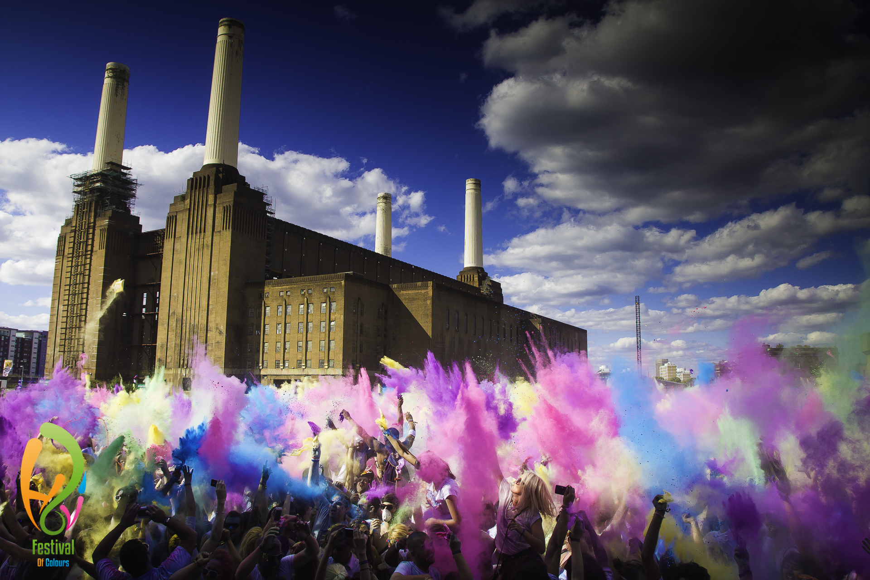
Thank you…

Slide 22
RISK TAKERS
Nuleka Ranasinghe
Pasindu Nuwantha
Sithira Janiya
Kavidi Athawuda
Lumini Himara
Kosala Perera
Sanuri Sathnara
Thisal Induwara
Reshmi Ruksala
Mohamed Muffasir
Ridmi Chamathka

Slide 23

Questions

